Slide 1
Kubevirt

Slide 2
What is KubeVirt?
KubeVirt is an extension for Kubernetes that enables running and managing virtual machines alongside containers.
It extends Kubernetes capabilities to support traditional virtualization workloads.

Slide 3
Key Features of KubeVirt
VMs as First-Class Citizens:
  With KubeVirt, virtual machines (VMs) are treated as first-class citizens in the Kubernetes environment.
Unified Management:
  KubeVirt allows users to manage both containers and VMs using the same Kubernetes API and toolset.
Portability:
  VMs can be managed and orchestrated just like containers, providing a unified experience for developers and operators.
Resource Management:
  KubeVirt integrates with Kubernetes' resource management features, enabling efficient use of resources for both VMs and containers.

Slide 4
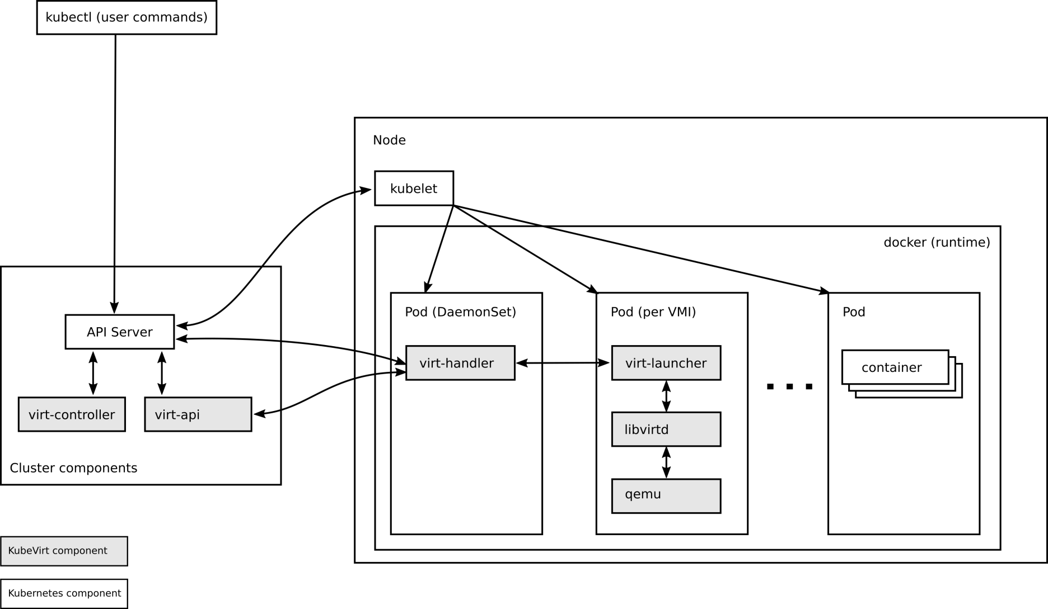
Architecture
The architecture of KubeVirt involves several components that work together to enable seamless integration of VMs into a Kubernetes cluster.
Here's an overview of the key components and their roles:
  Virt-controller
  Virt-api
  Virt-handler
  Virt-launcher

Slide 5
Virt-Controller : Manages the lifecycle of VMs within the Kubernetes cluster. It interacts with the Kubernetes API server to create, update, and delete VM resources.
Virt-handler: Translates Kubernetes VM objects into libvirt VM objects. It runs on each Kubernetes node and interacts with the hypervisor to manage VM instances.
Virt-api: Extends the Kubernetes API to introduce custom resources for defining and managing VMs. Users interact with the KubeVirt API to create VM objects and specify their configurations.
Virt-launcher: Responsible for launching and managing the QEMU/KVM processes that run the VMs. It works with Virtlet to create and manage actual VM instances on the nodes.

Slide 6


Slide 7
Use Cases
Legacy Application Migration:
  KubeVirt allows organizations to migrate traditional, legacy applications to a Kubernetes environment.
Mixed Workloads:
  Run both VMs and containers in the same Kubernetes cluster, allowing for flexibility in workload deployment.

